Slide 2
Light
Light is a type of energy that travels in waves. Light bounces off of stuff and we see colors and shapes because of it.

Slide 10
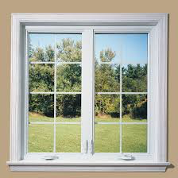
Transparent
A surface or object that lets light pass directly through it like a glass pane in a window

Slide 11
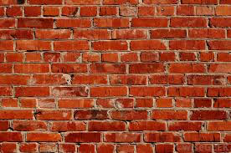
Opaque
A surface or item that does not let light pass through like a brick wall or cardboard box.

Slide 12
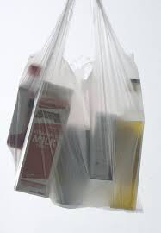
Translucent
A surface or object that lets some light through but is not completely transparent or opaque like a plastic shopping bag

